Slide 1
SARADA KRISHNA HOMOEOPATHIC MEDICAL COLLEGE,KULASEKHARAM,KK.DIST-629161.
PANCREAS
DR.BINO
Associate Prof.
DEPT OF SURGERY

Slide 2
ACUTE PANCREATITS
Inflammation of the pancreas and associated adjacent organs without evidence of chronic pancreatitis.

Slide 3
ETIOLOGY
Gall stones
Alcohol
Triglycerides
Drugs
Tumors/Obstruction
Trauma
Ischemia
Infection
Autoimmune
Hereditary
Idiopathic

Slide 4
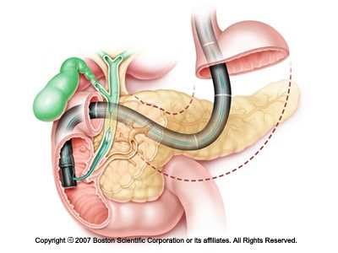
BILIARY SYSTEM

Slide 5
PATHOPHYSIOLOGY
Since starch and triglycerides are not stored in the pancreas, trypsin is the major catalyst for pancreatic autodigestion, not amylase or lipase (but later lipase gets to abdominal fat….)
PREMATURE/INTRACELLULAR activation of trypsin.
Leads to activation of chymotrypsinogen, more trypsinogen, elastase, phospholipase A2, complement, kinins->>AUTODIGESTION

Slide 6
CLINICAL FEATURES
SYMPTOMS
Upper abdominal pain ( mid epigastrium radiating to back/flanks )
<lying down, >sitting up
Persistent and severe vomiting and Nausea
PHYSICAL EXAMINATION
Low grade fever
Epigastric tenderness
Signs of shock
Abdominal distension
Mild Jaundice
Cyanosis
Discoloration of skin ( Cullen’s sign, Grey Turner’s sign )

Slide 7
Cullen’s sign
Discoloration of skin around Umbilicus.
Grey Turner’s sign
Discoloration of skin around loins.
(Such discolorations of skin varies from slate blue to mottled yellowish brown color due to ecchymosis and extravasated blood.)

Slide 8
INVESTIGATIONS
Elevated serum Amylase ( normal: 80-150 Somogyi units )
Elevation in the Serum and Urinary Lipase
Raised Amylase – Creatinine Clearance Ratio
Hyperglycemia
Hypocalcaemia
Abnormalities of LFT
Paracentesis
E.C.G abnormalities(depression of ST segment, prolonged QT interval, flattening of T waves)
USG, CT, MRI

Slide 9
MANAGEMENT-CONSERVATIVE
Management of Shock and Electrolyte imbalance
Relief of pain
Suppression of pancreatic secretions
Antacid therapy

Slide 10
SURGICAL MANAGEMENT
INDICATIONS OF SURGERY
Uncertain diagnosis
Deterioration of clinical condition
Correction of associated biliary tract disease
Secondary pancreatic infections
In case of local complications

Slide 11
COMPLICATIONS
Massive hemorrhage
Development of pseudocyst
Pancreatic fistula Pancreatic abscess
Recurrent infection
Diabetes mellitus

Slide 12
PROGNOSIS
Depends upon the stage of the disease.
After recovery of acute pancreatitis after an interval of 1 month pt should be thoroughly investigated for presence of biliary tract diseases.
Early death are due to MODS ( Multiple Organ Dysfunction Syndrome )

Slide 13
Thank you

